Slide 1
Business Architecture Metamodel Update
2017 Summit Update
Jeff Wallk - jeffrey.wallk@enablingvalue.com
www.businessarchitectureguild.org

Slide 2
Overview
Guild background and team structure
Business architecture framework recap
Business architecture knowledgebase
Knowledgebase and metamodel requirements
Sample metamodel from BIZBOK® Guide
What the Business Architecture Guild is doing to standardize metamodel views

Slide 3
Business Architecture Guild Background
Business Architecture Guild is an international not-for-profit, member association focused on expanding the practice of business architecture worldwide
The Guild creates, evolves and disseminates content through the work of close to two dozen, self-organized member teams
Teams work on white papers, reference models, webinar content, standards and iterations of A Guide to the Business Architecture Body of Knowledge® (BIZBOK® Guide)
The Guild is an active member of the Object Management Group® and the Open Group where it contributes to the evolution of business architecture and related standards, including TOGAF™

Slide 4
The Value Proposition
Goal – create an international standard for a business architecture metamodel that aligns to and implements the underlying metamodel in the BIZBOK® Guide
The Win – any tool aligned to a standard metamodel based on BIZBOK® Guide can input and export and ideally represent standard business architecture representations as defined by best practices in the BIZBOK® Guide
Tools will align more readily to best practices and reduce customization often required by in-house teams
Business architecture work will be streamlined and expedited

Slide 5
Business Architecture Framework Relies on Robust Knowledgebase
Business Architecture Knowledgebase
Source of Basic Framework:
(BIZBOK® Guide)
Knowledgebase: Manages business architecture metadata and relationships in easily accessed facility
Blueprints: On demand and ad hoc business architecture diagrams, extracts and reporting
Scenarios: Specific business context shaped by business objectives, related challenges, action items, plans

Slide 6
Knowledgebase is Based on BIZBOK® Guide’s Underlying MEtamodel
Business architecture maps various business domains that need to be accessible in a wide variety of ways
This perspective is reflected in the BIZBOK® Guide’s business architecture framework
Managing a well-articulated business architecture requires a robust knowledgebase – the centerpiece of that framework
Best practices and emerging standards dictate basic relationships
Repositories, databases and third party software enable management of knowledgebase
Best practices are evolving into standards for managing this information
In all cases a robust metamodel is needed to enable tool vendors and practitioners to represent, exchange and disseminate standard business architecture blueprints and related representations

Slide 7
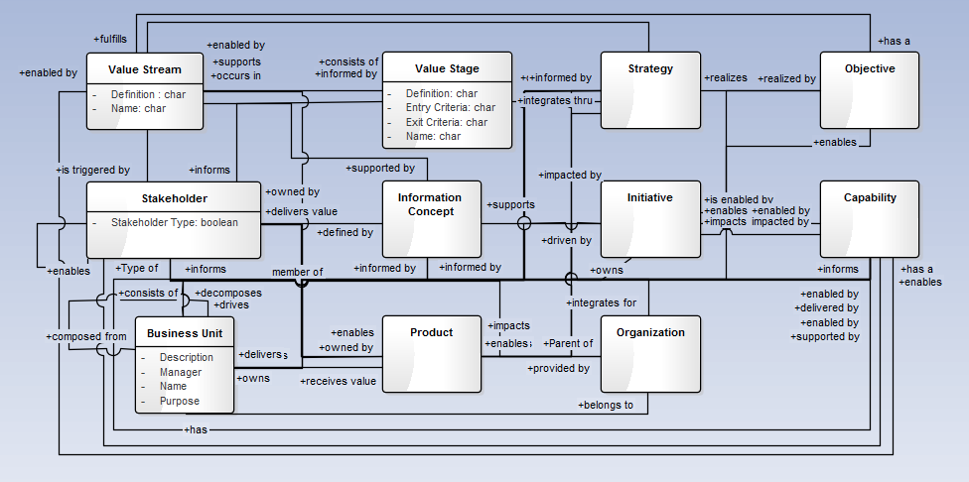
Sample Early Stage Metamodel from BIZBOK® Guide Part 5
Sample metamodel depicting relationships among business architecture artifacts
Source: BIZBOK® Guide Part 5
Notes:
A few years old, this earlier rendering provides a starting point showing the key concepts embodied in the BIZBOK
Relationships were informed by the BIZBOK, though they are not exhaustive (Appendix B4 explores these in greater detail)
The challenge with this earlier model is that all concepts have “equal footing”, which can open the door to inconsistencies for architects and business SMEs
When the current MM team embarked on the next generation model for the BIZBOK, we wanted to address some of these concerns to avoid multiple perspectives driving the business strategy for an organization
We’ll walk through the next generation model in a few slides and discuss how we addressed these concerns

Slide 8
Current Work in Progress by Guild Metamodel Team
Metamodel Design
Inviting international participants
Finalizing the core mappings
Drafting the penumbra
Object Management Group
OMG Business Architecture Metamodel RFP drafted
Targeting standard submissions for 2018
Open Group
Guild is active member working on business architecture efforts
Contributing recommendations to update Open Group TOGAF™ content model
Vendor Engagement
Collaborating with tool vendors on metamodel design
Inviting vendors to join Guild in a formal submission response

Slide 9
Metamodel Team Roadmap (2017/2018 Timeline)
Q1
Q2
Q3
Q4
Q1
OMG RFP
RFP Response
MM Design
Core
Penumbra
Extensions
BIZBOK® Updates
Vendor Engagement
The team is working on multiple threads. Much work and time was spent in the last 12-18 months incorporating new thinking and approach for the metamodel, engaging constituencies in OMG to socialize and build consensus towards a Business Architecture Metamodel RFP, and working with the vendor community to outline opportunities for ongoing collaboration and participation for the future.

Slide 10
Capability as the centerpiece
Capability is the natural starting point for a business architecture because it describes “what” a business does in a way that supports analysis of various related business management concerns by:
Engaging business and operational stakeholders about their relevant concerns (current state), and
Guiding them towards a progressive set of steps to achieve their goals and objectives (strategy) for the short-term and long term (future states)

Slide 11
BIZBOK® Based, Layered MetaModel View
Represents “core” business architecture domains
Notes:
The core concepts of the current generation BA MM will be familiar to members of the Guild who have read the BIZBOK.
The same 4 concepts can be found on the first diagram in Part 1.
The primary difference is that we made Capability a “1st Class Citizen” in the next gen MM.
This purposeful change ensures that capability is the starting point for aligning perspectives across the business architecture
The alignment is achieved using relationships that are contextualized by semantics to address each perspective.
The easy part is identifying the concepts, the hard part is defining the relationships that allows the business architect to incorporate the semantic context…

Slide 12
First 2 layers of metamodel
Penumbra
Business Strategy Mapping
Initiative Mapping
Product Mapping
Stakeholder Mapping
Policy Mapping
BPM and Management
Case Management
Business Performance Mgmt.
Requirements Alignment
Core
Capability – Centerpiece defines WHAT the business does
Value – defines WHY the business has the capabilities
Information – HOW we build alignment between Capability, Value, and Organization
Organization – HOW we align resources to deliver value

Slide 13
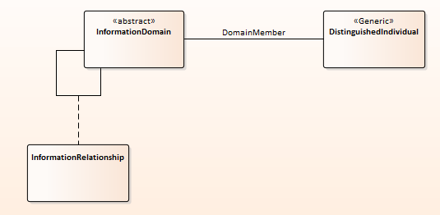
Draft Metamodel Packages for core Business Architecture Domain Packages
Draft Version of Capability Package
Draft Version of Information Package
Notes:
Capability Package:
Capabilities can be composed of one or more capabilities (supporting levels of granularity)
Capability Maps rely on to support top-down (decomposition) or bottom-up (composition) of capabilities
We are exploring Capability Instance as a mechanism to provide a future alignment to Processes, Events, and Activities (any of which can trigger )
We’re currently exploring an assembly capability as there are many scenarios (and variable) to consider once you step down into the Process Realm
One or more Capability Instances can be associated with a Capability
Required Outcomes suggest those imposed by compliance driven stakeholders (directly or indirectly)
Whereas Produced Outcomes are what actually get delivered by a Capability (again, with varying levels of granularity)
The Informative Outcome provides a hook into the Information Package where we can explore the nuances of context (informed by semantic expressions supporting individual perspectives)
Information Package:
The Information Domain contextualizes the data and information associated with the organization’s business model and verticals they participate in
The meta class (Distinguished Individuals) provides a reference to stakeholders and supports the alignment between Informative Outcomes and Value Proposition to arrive at perspective for a specific individual
This package is evolving as we continue to iterate the Organization package on the next slide

Slide 14
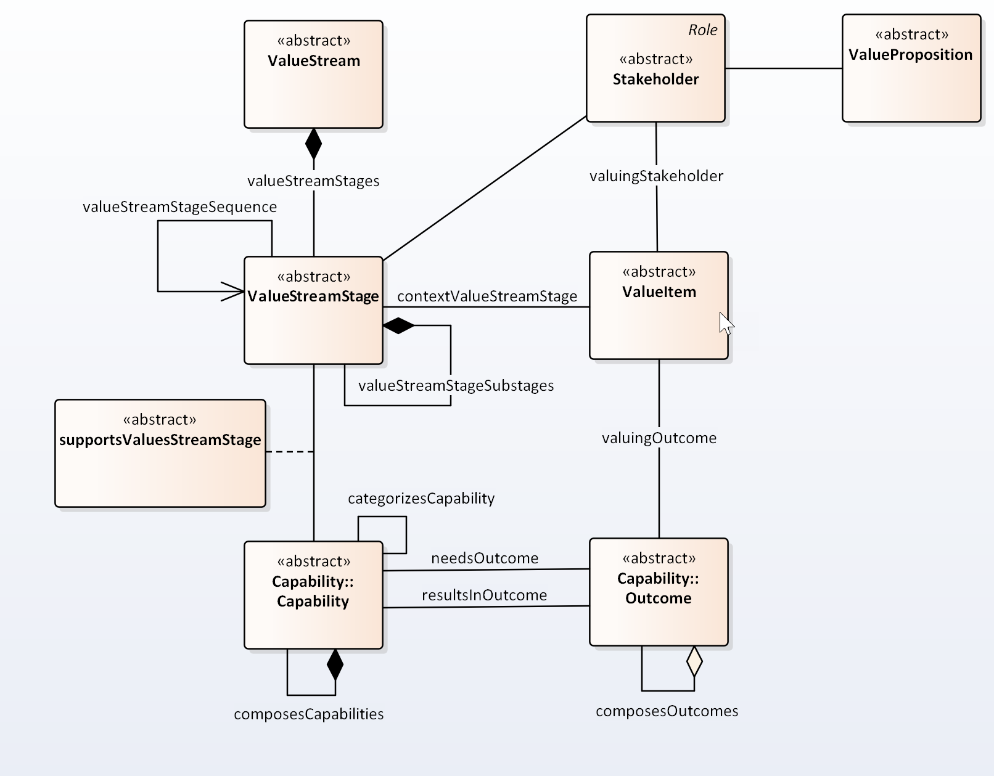
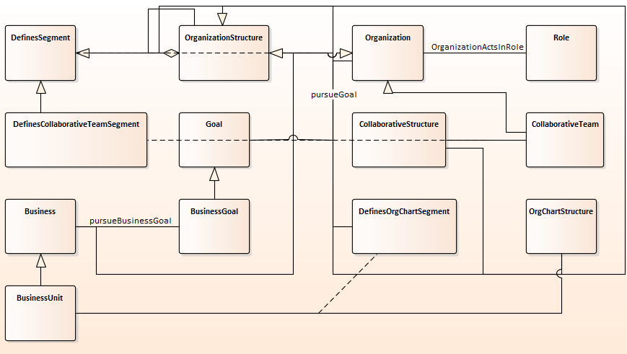
Draft Metamodel Packages for core Business Architecture Domain Packages
Draft Version of Organization Package
Draft Version of Value Stream Package
Notes:
Organization Package:
We’re using the term “organization” versus “party” (which is traditional in data modeling / data architecture discussions)
Think of organization as an ”uber” social unit of individuals and groupings of individuals (defined business areas, business units, various org structures, collaborative structures, and virtual teams
We stepped back from focusing on Business Unit to provide more of a logical element / segment of a company which (typically) ties to business goals
Again, we’re still iterating this package (trying to resist the temptation to infuse strategy / strategic elements into the Org Package)
This loosely coupled set of structures supports traditional command & control, federated models and even extends nicely into social networks
Value Package:
Value Stream is a composition of Value Stream Stages (not an aggregate)
Value Stream Stage is comprised of Value Items
Value Streams can have many stakeholders (and perspectives)
Which is why we associated Value Proposition with Stakeholder
Stakeholders (customers) typically interact with Value Items which are generated from Value Streams
However, some Stakeholders (supply chain and value chain partners) may interact at the Value Stream Stage
The interpretation of Value is through the Stakeholder’s perspective as they interact with the Value Item (presumably a product or service)
Note: There are various “event” that may trigger processes that can impact a Value Stream Stage (e.g. market forces, environmental changes, political changes, etc.) We are working through ways to express those in some of our future efforts…
We hope to provide another update in Q3/Q4 timeframe.

Slide 15
OMG RFP View of Business Architecture Metamodel Response Requirements
Capability required
Other representations desired
Must interface with existing standards
Capability Oriented Business Perspective

Slide 16
Scenario-Driven Business Architecture MetaModeling
The business architecture metamodel was derived from business architecture best practices as outlined in the BIZBOK® Guide and the organizations by leveraging common business scenarios
Investment Analysis
Shift to Customer Centric Business Model
Merger & Acquisition Analysis
New Product/Service Rollout
Globalization
Business Capability
Outsourcing
Supply Chain Streamlining
Divestiture
Regulatory Compliance
Change Management
Operational Cost Reduction
Joint Venture Deployment

Slide 17



Vendor Engagement – Discussion Engagement
Variations for candidate metamodel have been adopted, are under review for adoption, or have been or are being user implemented across numerous tool vendors
Candidate metamodel is based on the concepts captured across practitioner communities, as embodied in the BIZBOK® Guide, which has wide adoption across government, institutions, commercial, and non-profit (US & International)
Next steps – Guild will engage with vendor community in more focused ways to submit a response to the OMG RFP

Slide 18
Related Standards and Tool Work
Guild engaged with OMG for long-term to work on rollout and evolution of a standard metamodel
Guild also a member of Open Group to influence TOGAF® and its content model
Guild team has created a UML Profile for BIZBOK® for UML based tools
This could be standardized as well and aligns to the Guild metamodel

Slide 19
Thank you
We are looking for additional participants to accelerate
our efforts on this landmark work plan. Please contact the
Team Leader (Jeffrey Wallk) on the Guild Site (see link)
Jeff Wallk - jeffrey.wallk@enablingvalue.com
(http://www.businessarchitectureguild.org)

Slide 20
Questions….
1. When can we get a look at the Guild’s business architecture metamodel?
2. Can I start using the business architecture metamodel before it’s a standard ? Any risks in doing so?
3. How do you plan on aligning the business architecture metamodel with preexisting OMG metamodel standards?
4. Is there any guidance for selecting a modeling tool suited for business architecture based in part on metamodel alignment?
5. How should an architect leverage the business architecture metamodel on projects?
6. Is there any guidance for selecting a modeling tool suited for business architecture for projects?
7. How will the business architecture metamodel help us align and/or optimize our IT portfolio ?
Notes:
Question 1:
We can say that the group will be posting updates to members of the group on a regular basis, but only publishing to the wider audience when we make updates to the BIZBOK. If a Guild member reaches out to ask specifically for an update, we can handle these on a 1:1 basis.
Question 2:
I don’t see much risk to using the MM before it becomes a standard. Any changes are likely to be minor, but the concepts still hold. A separate topic that the team needs to discus is just exactly how would any architect leverage a MM, since it’s an abstracted reference model and they would need to be familiar with a progression of modeling disciplines (conceptual -> logical -> physical), which would actually be an interesting webinar unto itself.

